Slide 1



house price data analysis
View in Power BI
Last data refresh:
6/10/2023 2:04:05 PM UTC
Downloaded at:
6/10/2023 2:09:26 PM UTC

Slide 2
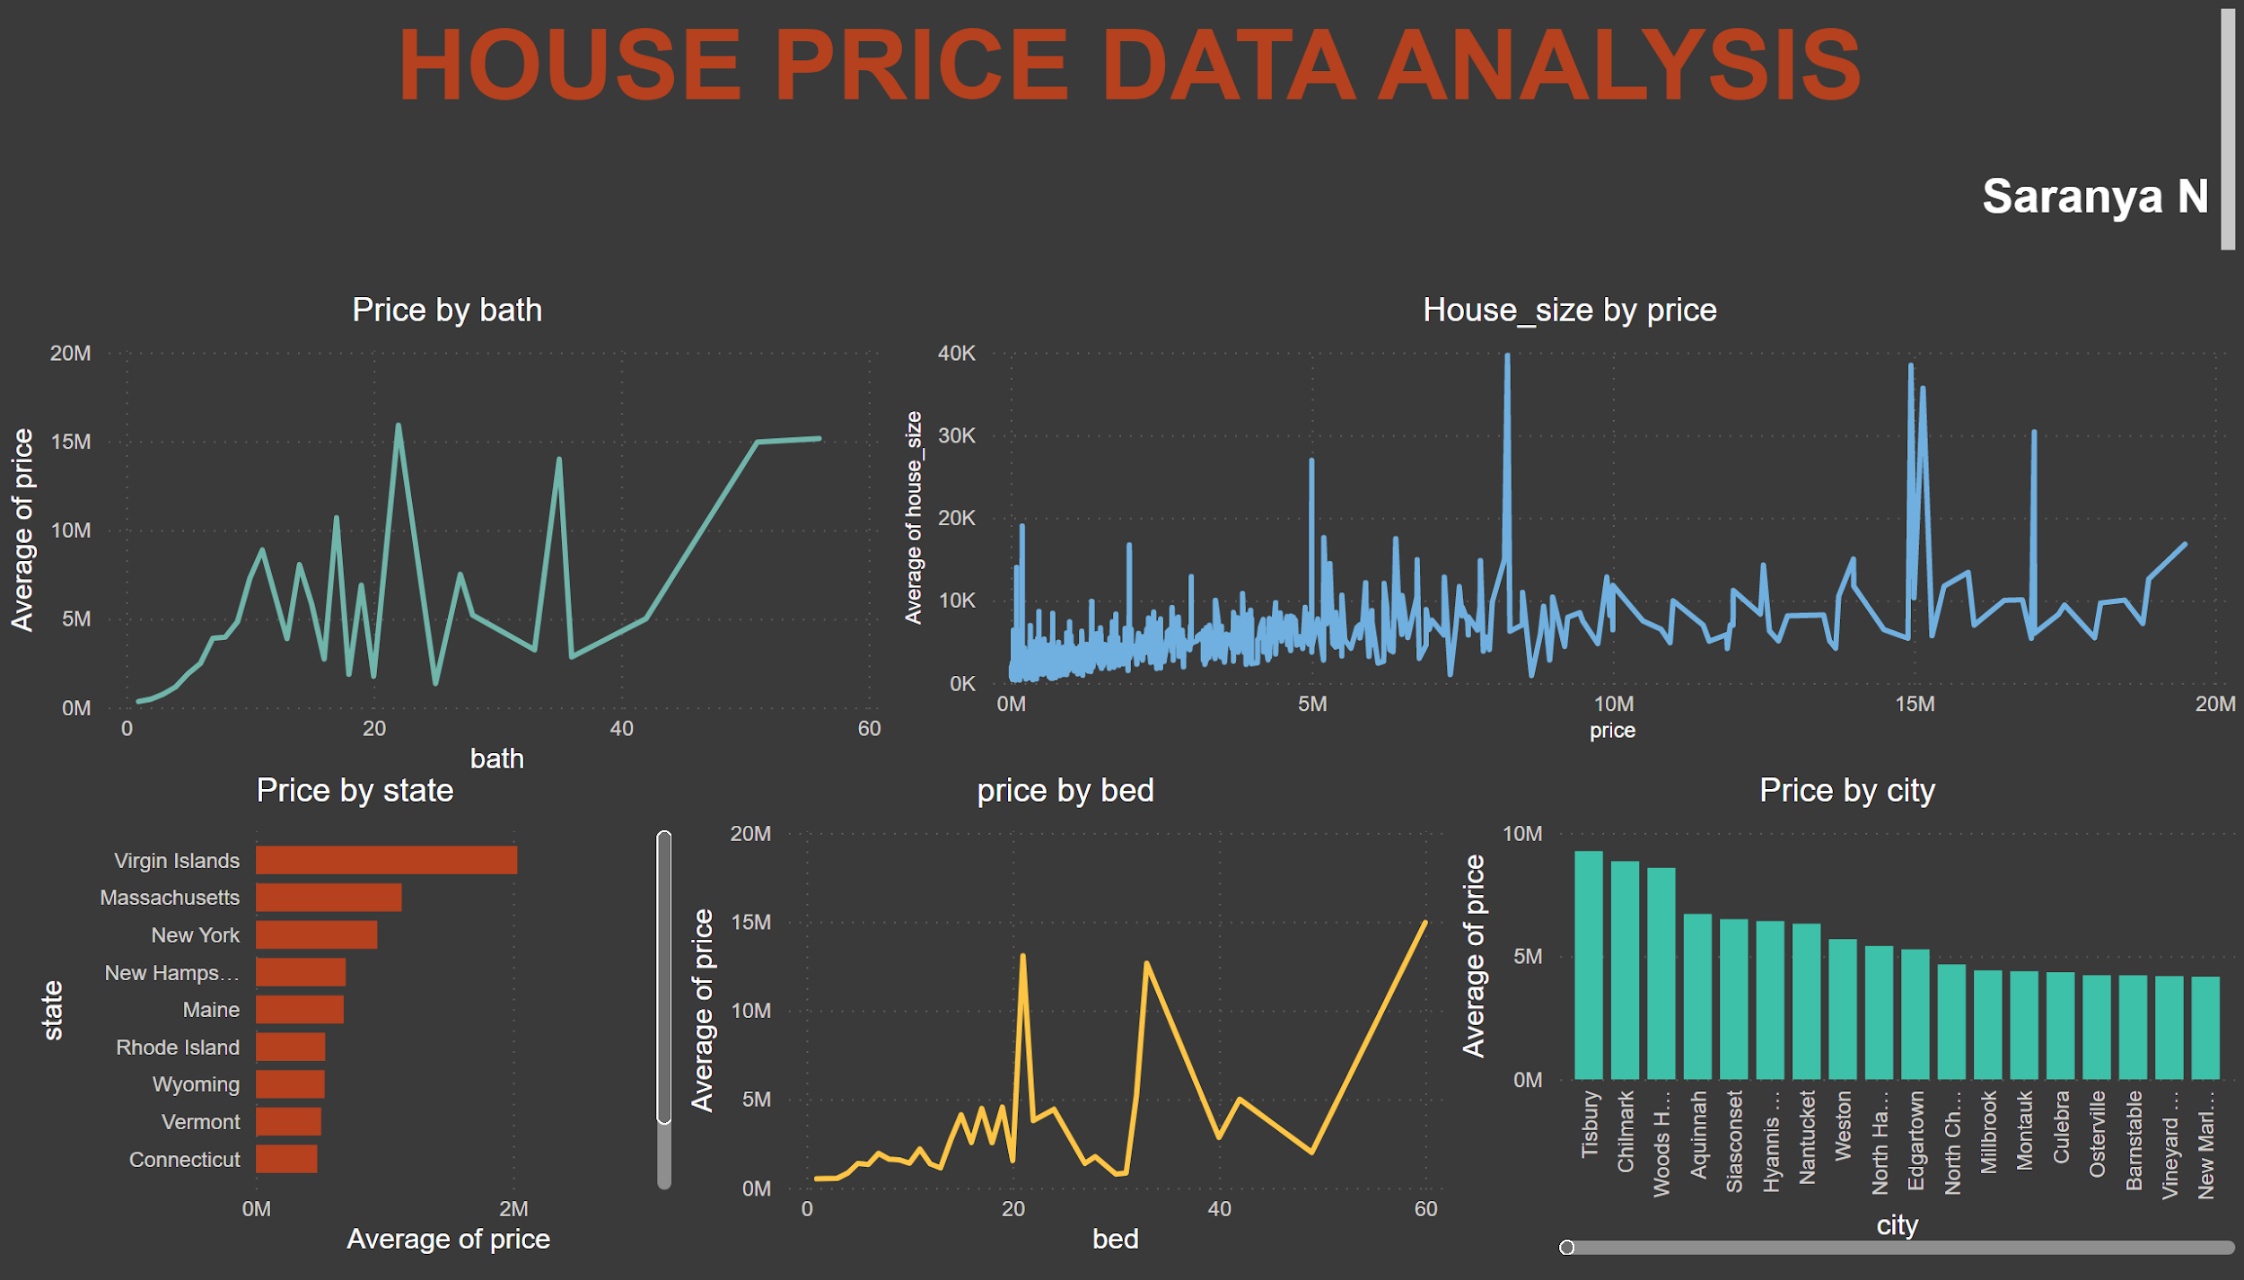
Notes:
Price by bath
No alt text provided
price by bed
No alt text provided
Price by state
No alt text provided
Price by city
No alt text provided
House_size by price
No alt text provided
textbox
No alt text provided

